Slide 1
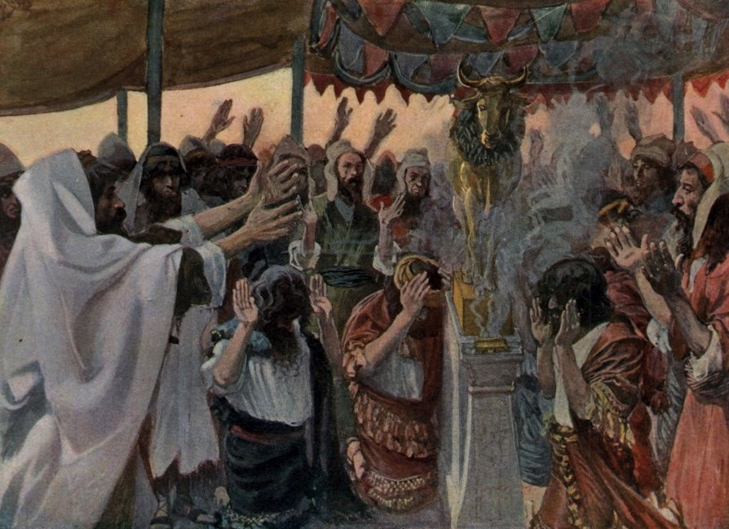
When You're Idle About Idols
1 Corinthians 10
Dr. Rick Griffith • Crossroads International Church Singapore
cicfamily.com & BibleStudyDownloads.org

Slide 2
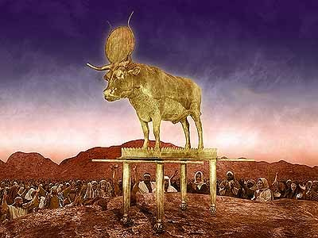
The Golden Calf
Written by Emily Akin
Notes:
www.christian-drama.org/files/christian-drama/golcal.doc

Slide 3
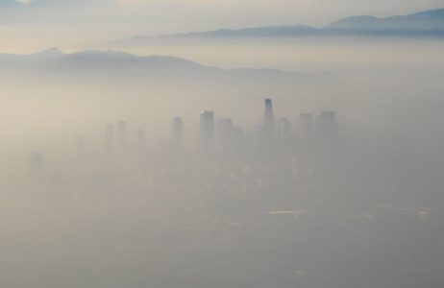
LA Smog

Slide 4
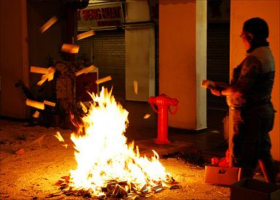
Fires

Slide 5
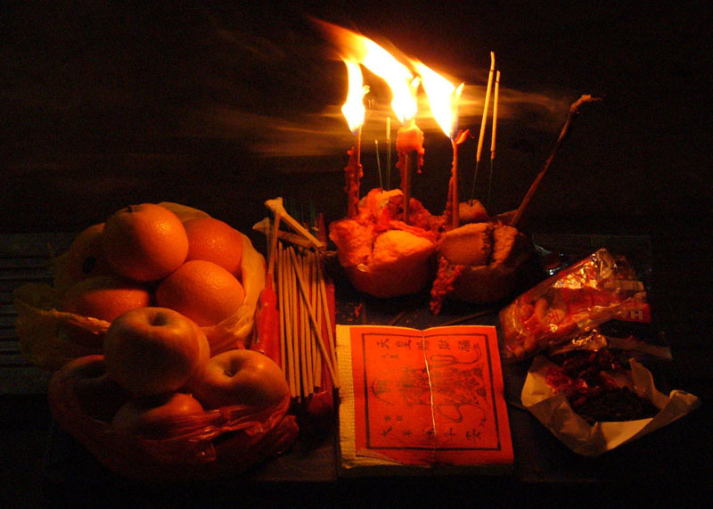
The Hungry Ghost

Slide 6
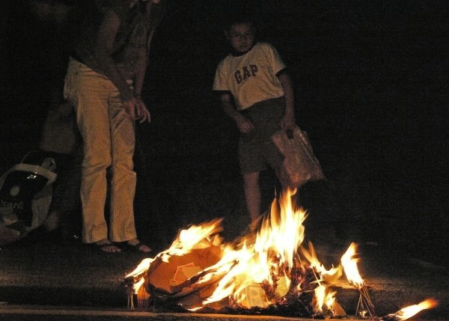
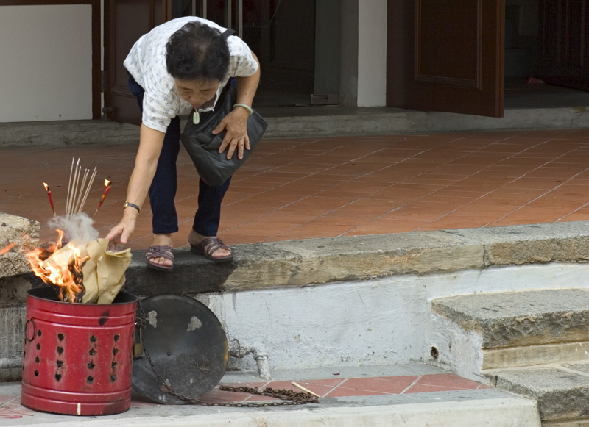
Fires

Slide 7

The Hungry Ghost

Slide 8
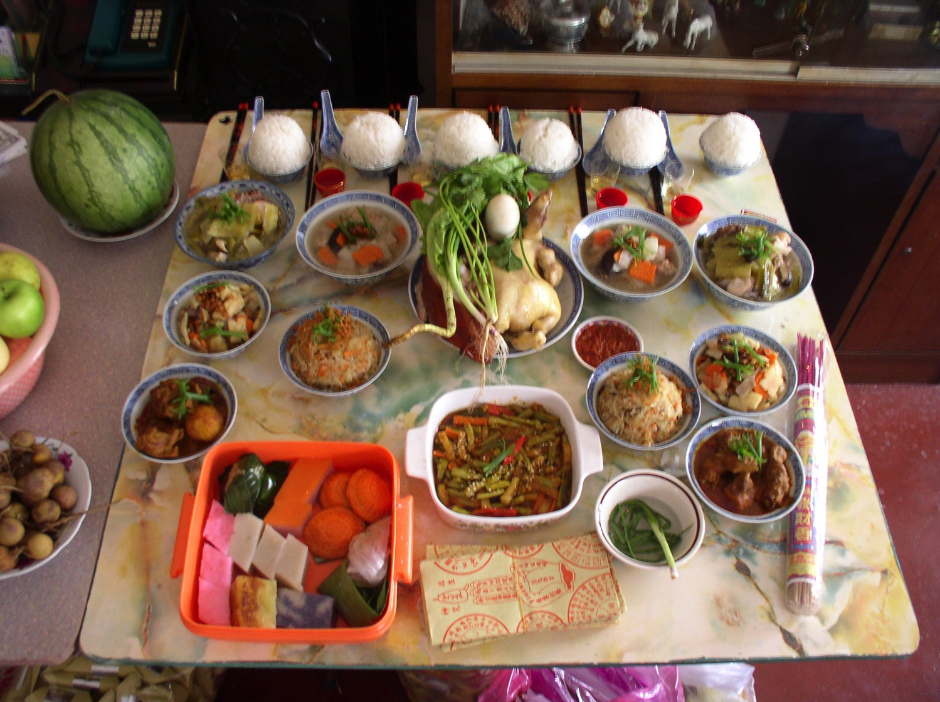
The Hungry Ghost

Slide 9
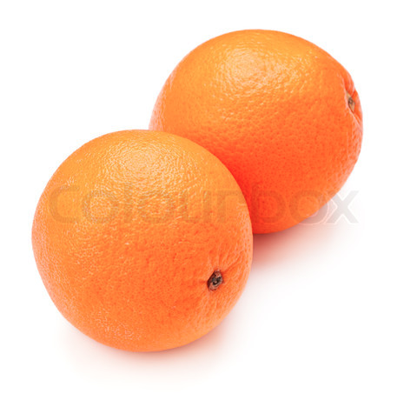
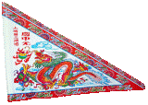
"Celebrate the Seventh Month!"

Slide 10
Black

Slide 11

What would you have done?
Eat?
Give?
Toss?

Slide 12
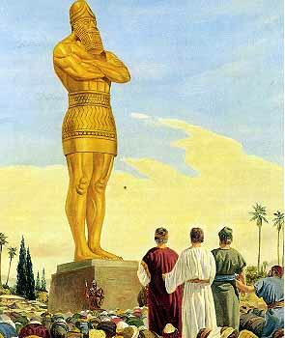
Most Bow Down

Slide 13
The Golden Calf
Written by Emily Akin
Notes:
www.christian-drama.org/files/christian-drama/golcal.doc

Slide 14

Notice which letter comes first

Slide 15

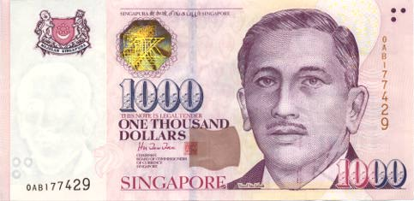

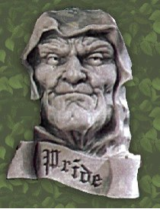
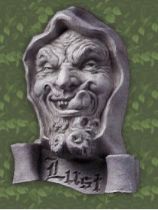
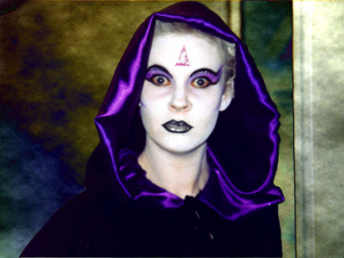
Why no…
Idolatry?

Slide 16
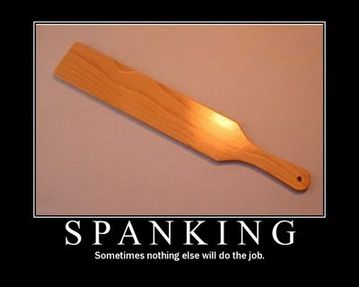
I. Idolatry reaps God's discipline (1-13).
SPANKING
Sometimes nothing else will do the job

Slide 17
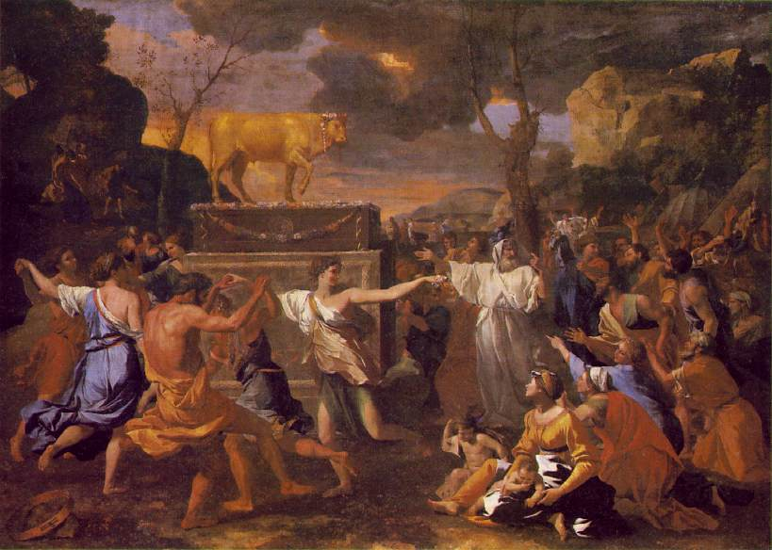
A. God judged Israel for its evil practices as a warning to us
(1-11).

Slide 18

Wandering Map
Kadesh- barnea
Mt. Hor
Mt. Sinai
Route of the Journey

Slide 19

1 Cor. 10:1-4 (NLT)
¹I don't want you to forget, dear brothers and sisters, about our ancestors in the wilderness long ago. All of them were guided by a cloud that moved ahead of them, and all of them walked through the sea on dry ground. ²In the cloud and in the sea, all of them were baptized as followers of Moses. ³All of them ate the same spiritual food, ⁴and all of them drank the same spiritual water. For they drank from the spiritual rock that traveled with them, and that rock was Christ.

Slide 20
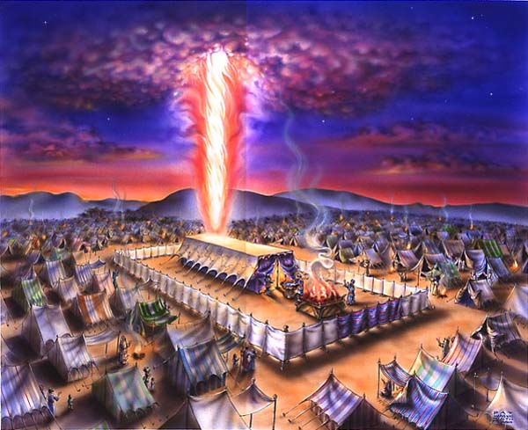
The Cloud
Exodus 40

Slide 21


The Sea
Exodus 12

Slide 22

The Leader
Exodus 12

Slide 23
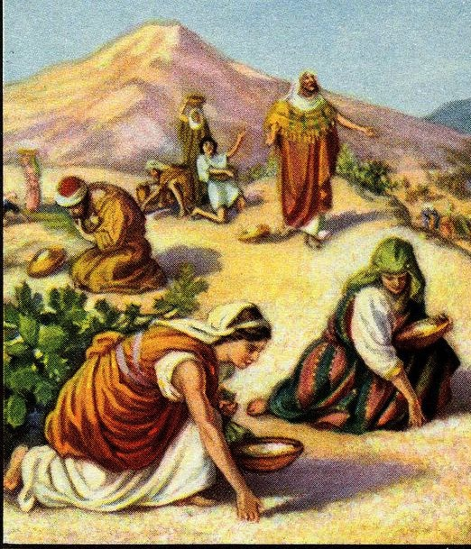
The Food
Exodus 16

Slide 24
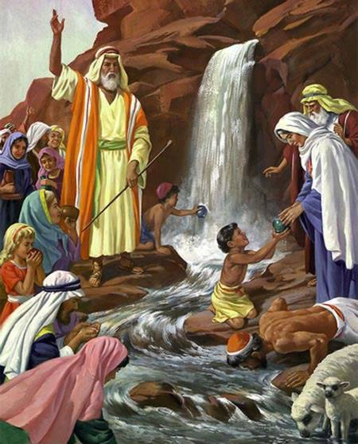
The Water
Exodus 17

Slide 25
1 Cor. 10:5 (NLT)
⁵Yet God was not pleased with most of them, and their bodies were scattered in the wilderness.

Slide 26
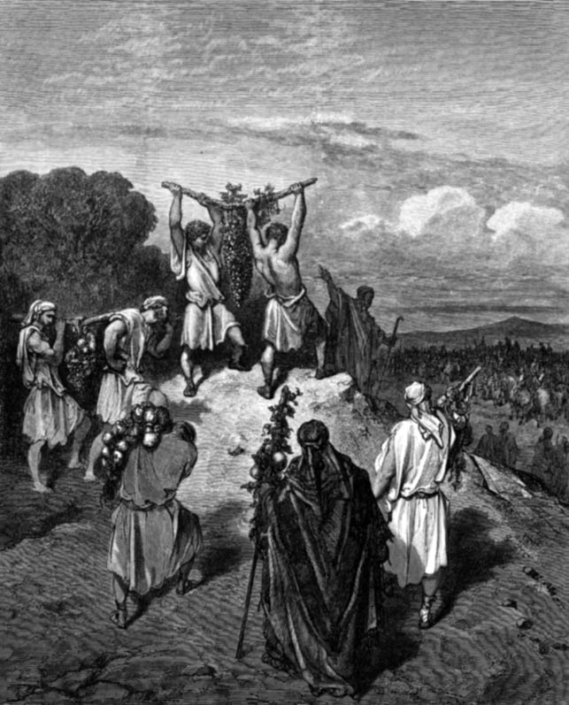
The Spies Return
Numbers 13

Slide 27
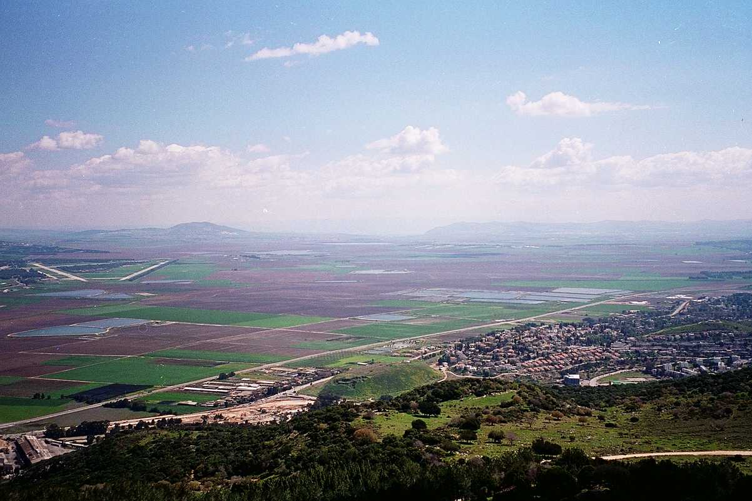
The Majority Report
G
ood
iants
rasshoppers
Numbers 13:26-33

Slide 28
The Minority Report
G
OD
Numbers 13:26-33

Slide 29
God's Report
Num. 13:26-14:9
DRESSING
THE
STAGE
Here's the situation:
MS
TWELVE SPIES: TWO REPORTS
10 SPIES: A MAJORITY OPINION
LAND OF MILK AND HONEY!
GIANTS IN THE LAND!
GO BACK TO EGYPT!
2 SPIES: A MINORITY OPINION
LAND OF MILK AND HONEY!
GIANTS IN THE LAND!
GOD IS WITH US!
N(A)
TRIP CANCELLED!
H
SG
C
ER
B
J
MN
MOSES
DS
Exodus
Sinai
E
M - C - C
Kadesh Barnea
KB
U
40
MS
PG
SO...LET'S GO!!!!!
RS
Handbook pg. 26-29
21

Slide 30
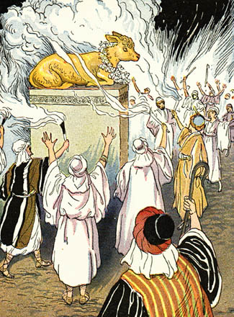
The Golden Calf Incident
Exodus 32

Slide 31
1 Cor. 10:6-8 (NLT)
These things happened as a warning to us, so that we would not crave evil things as they did, ⁷or worship idols as some of them did. As the Scriptures say, “The people celebrated with feasting and drinking, and they indulged in pagan revelry.” ⁸And we must not engage in sexual immorality as some of them did, causing 23,000 of them to die in one day.

Slide 32
1 Cor. 10:9-11 (NLT)
⁹Nor should we put Christ to the test, as some of them did and then died from snakebites. ¹⁰And don't grumble as some of them did, and then were destroyed by the angel of death. ¹¹These things happened to them as examples for us. They were written down to warn us who live at the end of the age.

Slide 33
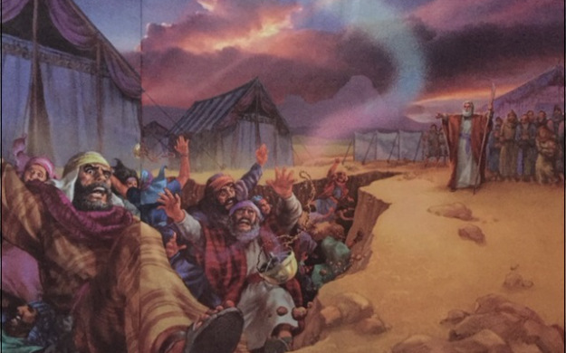
Korah's Rebellion
Korah, Dathan and Abiram (Numbers 16:31-34)

Slide 34
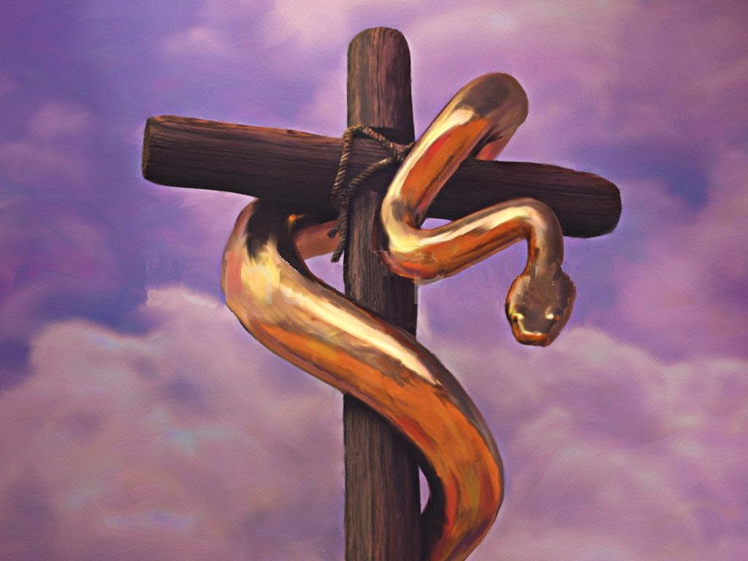

The Bronze Serpent
Numbers 21:8-9
Notes:
• The bronze serpent appears in dual form on the seal of the American Medical Association.

Slide 35
Black

Slide 36
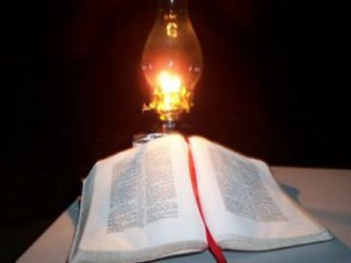
B. Humbly accept God's help when tempted (12-13).

Slide 37
1 Cor. 10:12 (NLT)
12 If you think you are standing strong, be careful not to fall.

Slide 38
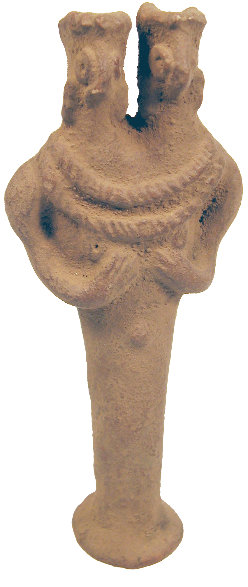

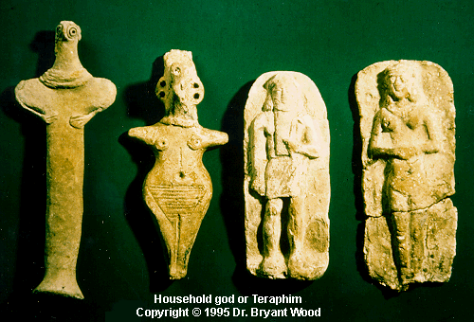
Idols are Wrong

Slide 39

“Idolatry is OK” Man

Slide 40

“Idolatry is OK” Woman

Slide 41
Black

Slide 42
1 Cor. 10:13 (NLT)
¹³The temptations in your life are no different from what others experience. And God is faithful. He will not allow the temptation to be more than you can stand. When you are tempted, he will show you a way out so that you can endure.

Slide 43
Black

Slide 44
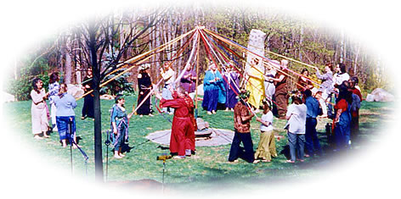
C. God will judge you for your involvement in paganism.

Slide 45
Black

Slide 46
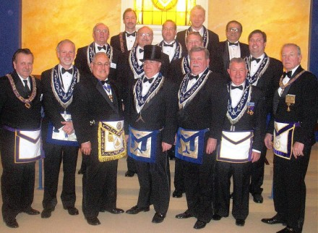
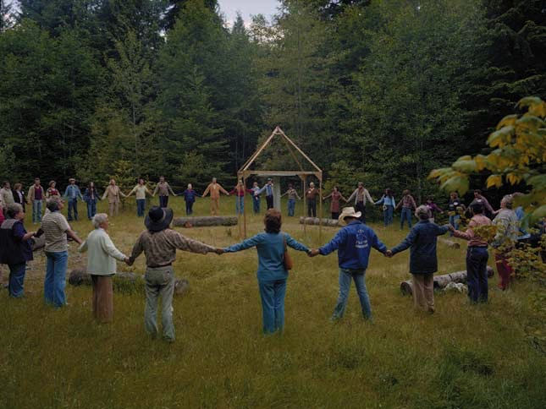

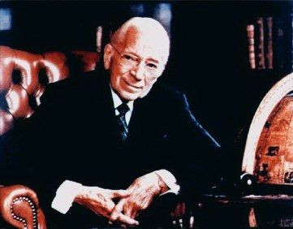
Principal Candidate
Masons
New Age
Armstrong's Worldwide Church of God
Rosicrucian Fellowship

Slide 47

God judges sexual sin too
HPV
50% of sexually active women ages 18-22!

Slide 48

How many really have AIDS?

Slide 49
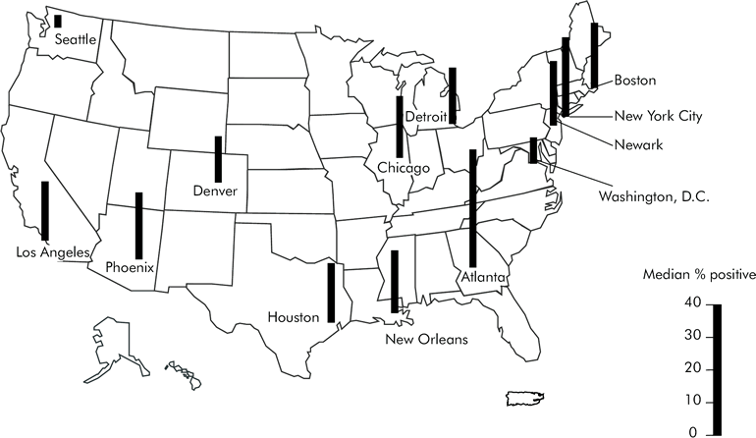
HIV Stricken Homosexual Men, 1997
Includes only areas with sufficient data for analysis.
http://www.cdc.gov/hiv/topics/testing/resources/reports/hivser97/figures.htm

Slide 50
Black

Slide 51
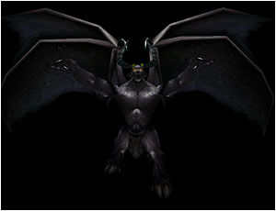
II. God judges our idolatry because it is demonic (14-22).

Slide 52

A. Avoid idol feasts since they're as demonic as the Lord's Supper is godly (14-22).

Slide 53
1 Cor. 10:14 (NLT)
¹⁴So, my dear friends, flee from the worship of idols.

Slide 54

The Body. The Blood.

Slide 55
1 Cor. 10:15-18 (NLT)
¹⁵You are reasonable people. Decide for yourselves if what I am saying is true. ¹⁶When we bless the cup at the Lord's Table, aren't we sharing in the blood of Christ? And when we break the bread, aren't we sharing in the body of Christ? ¹⁷And though we are many, we all eat from one loaf of bread, showing that we are one body. ¹⁸Think about the people of Israel. Weren't they united by eating the sacrifices at the altar?

Slide 56

The Agape (Love) Feast

Slide 57
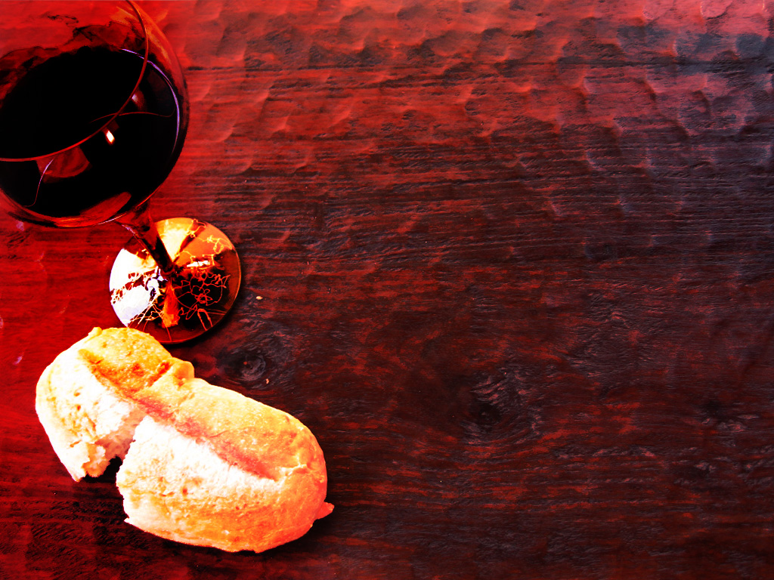
The Cup
Christ
The Bread
Others
1 Corinthians 10:16

Slide 58
1 Cor. 10:19-22 (NLT)
¹⁹What am I trying to say? Am I saying that food offered to idols has some significance, or that idols are real gods? ²⁰No, not at all. I am saying that these sacrifices are offered to demons, not to God. And I don't want you to participate with demons. ²¹You cannot drink from the cup of the Lord and from the cup of demons, too. You cannot eat at the Lord's Table and at the table of demons, too. ²²What? Do we dare to rouse the Lord's jealousy? Do you think we are stronger than he is?

Slide 59

Sacrifice for the Communal Meal

Slide 60
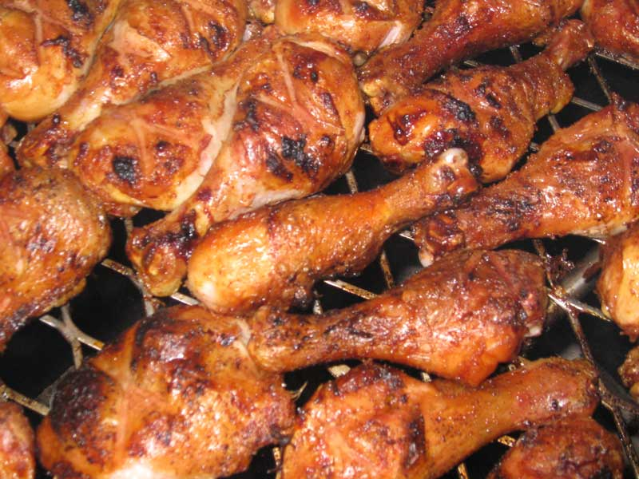
Sacrifice for the Communal Meal

Slide 61

B. Exposing ourselves to demons in pagan celebrations invites God's discipline.

Slide 62
Black

Slide 63
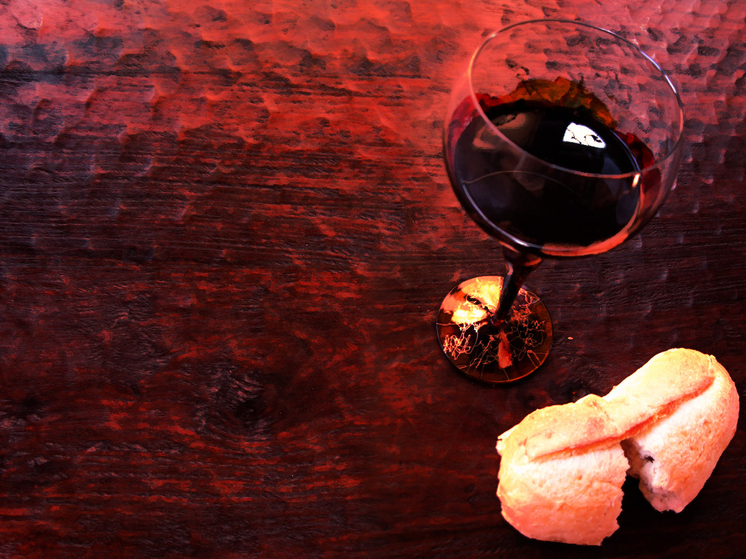
1 Corinthians 11:27-29 (NLT)
²⁷Therefore, whoever eats the bread or drinks the cup of the Lord in an unworthy manner will be guilty of sinning against the body and blood of the Lord. ²⁸A man ought to examine himself before he eats of the bread and drinks of the cup. ²⁹For anyone who eats and drinks without recognizing the body of the Lord eats and drinks judgment on himself.
Notes:
63

Slide 64
1 Corinthians 11:30-32 (NLT)
³⁰ That is why many among you are weak and sick, and a number of you have fallen asleep. ³¹But if we judged ourselves, we would not come under judgment. ³²When we are judged by the Lord, we are being disciplined so that we will not be condemned with the world.
Notes:
64

Slide 65
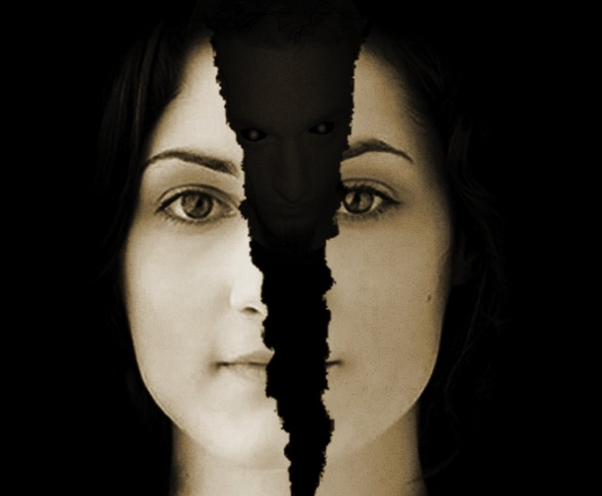
Avoid idolatry or God may discipline you for this involvement with demons
Main Idea

Slide 66
How NOT to be idle with idols…
  Be humble (12)
  Trust in God's faithfulness (13)
  Flee every form of idolatry (14)

Slide 67
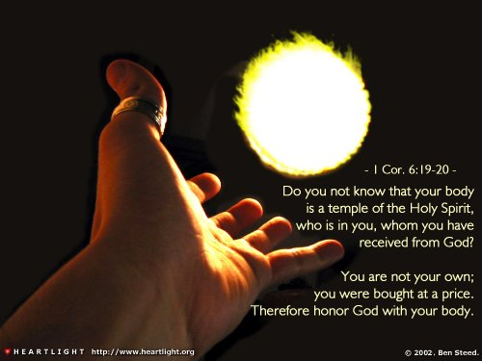
Don't play with fire!

Slide 68
How NOT to be idle with idols…
  Be humble (12)
  Trust in God's faithfulness (13)
  Flee every form of idolatry (14)
  Seek the good of others (23-30)

Slide 69
1 Cor. 10:23-24 (NLT)
²³You say, “I am allowed to do anything”–but not everything is good for you. You say, “I am allowed to do anything”–but not everything is beneficial. ²⁴Don't be concerned for your own good but for the good of others.

Slide 70
1 Cor. 10:25-27 (NLT)
²⁵So you may eat any meat that is sold in the marketplace without raising questions of conscience. ²⁶For “the earth is the Lord's, and everything in it.”
²⁷If someone who isn't a believer asks you home for dinner, accept the invitation if you want to. Eat whatever is offered to you without raising questions of conscience.

Slide 71
1 Cor. 10:28-30 (NLT)
²⁸(But suppose someone tells you, “This meat was offered to an idol.” Don't eat it, out of consideration for the conscience of the one who told you. ²⁹It might not be a matter of conscience for you, but it is for the other person.) For why should my freedom be limited by what someone else thinks? ³⁰If I can thank God for the food and enjoy it, why should I be condemned for eating it?

Slide 72
Black

Slide 73
How NOT to be idle with idols…
  Be humble (12)
  Trust in God's faithfulness (13)
  Flee every form of idolatry (14)
  Seek the good of others (23-30)
  Glorify God (10:31–11:1)

Slide 74
1 Cor. 10:31–11:1 (NLT)
³¹So whether you eat or drink, or whatever you do, do it all for the glory of God. ³²Don't give offense to Jews or Gentiles or the church of God. ³³I, too, try to please everyone in everything I do. I don't just do what is best for me; I do what is best for others so that many may be saved. ^{11:1} And you should imitate me, just as I imitate Christ.

Slide 75
Black

Slide 76


NT Preaching link at BibleStudyDownloads.org
Get this presentation and script for free!
Notes:
NT Preaching (np)

